Slide 1

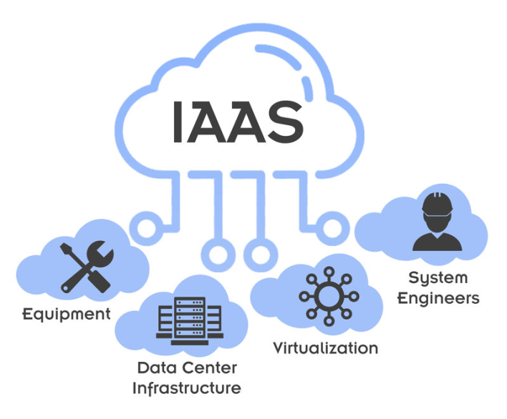
Lab 01 - Public Cloud
https://bit.ly/3uT4mhp

